Slide 1
DISEASE PREDICTION THROUGH SYMPTOMS
Guided by : Presented by:
DR.NADERA BHEEVI S S R NIKHIL KRISHNAN
ROLL NO: MCA23-152

Slide 2
Introduction
In the healthcare domain, early and accurate diagnosis of diseases is critical for effective treatment and improved patient outcomes.
Many individuals delay seeking medical attention due to a lack of access to healthcare services or self-assessment of symptoms.
The goal is to develop a model to get a primary analysis based on symptoms to predict the disease and to get the necessary treatments

Slide 3
PROBLEM STATEMENT
There is a need for an intelligent system that can predict potential diseases based on a set of input symptoms.
By leveraging several machine learning and deep learning algorithms, such a system could assist patients and healthcare professionals in providing initial diagnosis or guiding the next steps for medical care.
A user interactive front end is also implemented in this project

Slide 4
GAP IDENTIFIED
Limited Accuracy-By using less complex Machine Learning algorithms only limited accuracy was obtained
Limited Input Type-Input could only be given by a specific format and when not followed gets wrong predictions
Dataset-The datasets used were those which contained binary values and no real world inputs and also only contained less number of values

Slide 5
PROPOSED SYSTEM
High Accuracy-Used more complex Deep Learning algorithms like CNN and LSTM
Input Type – Used NLP so that input could be given in any format
Dataset –Used a dataset which has real world examples and larger in size

Slide 6
METHODOLOGY
DATA COLLECTION
DATA PREPROCESSING
FEATURE EXTRACTION
MODEL TRAINING
PREDICTION
DISEASE
TREATMENT

Slide 7
RESULT AND ANALYSIS
KNN Accuracy-87%
 | CNN | LSTM
Train Accuracy | 98.28% | 98.11%
Validation Accuracy | 88.33% | 87.50%
Test Accuracy | 88.28% | 85.42%

Slide 8
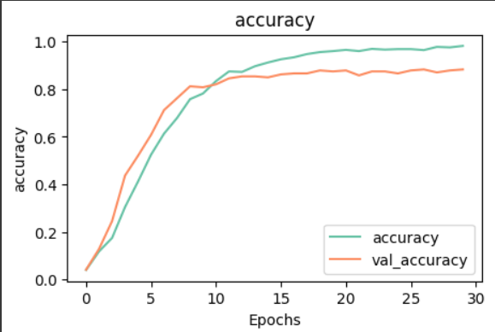
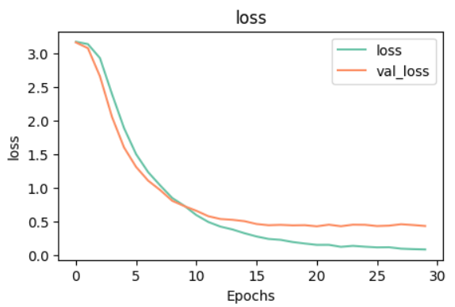
RESULTS(CNN)

Slide 9
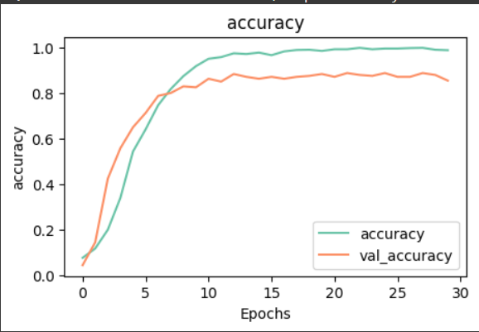
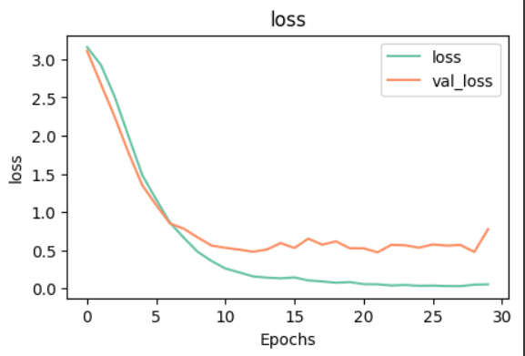
RESULTS(LSTM)

Slide 10
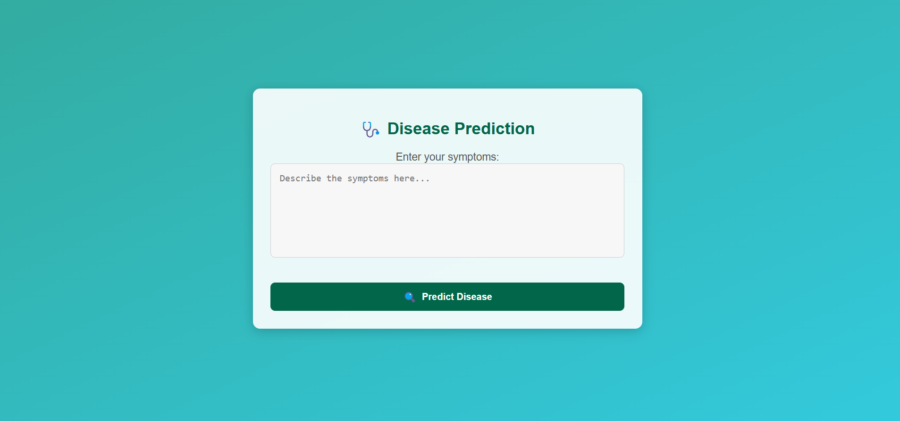
SCREENSHOTS

Slide 11
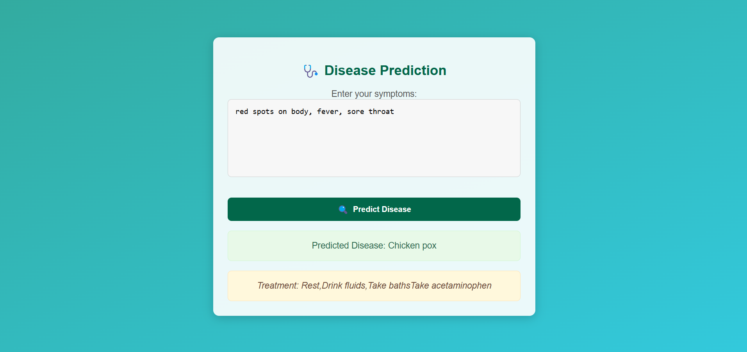

Slide 12
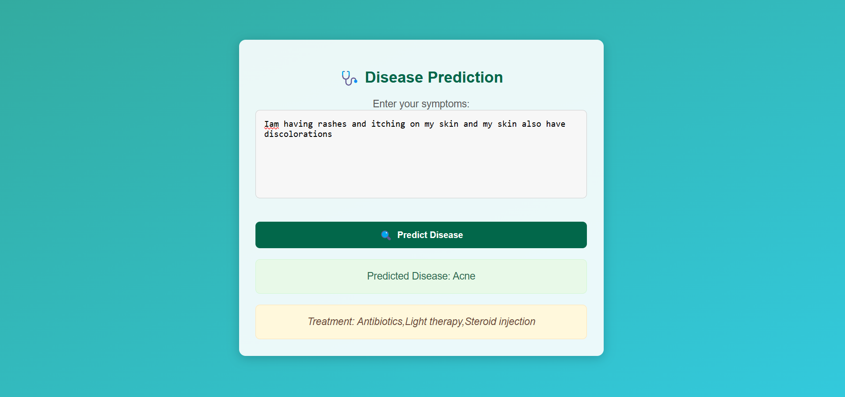

Slide 13
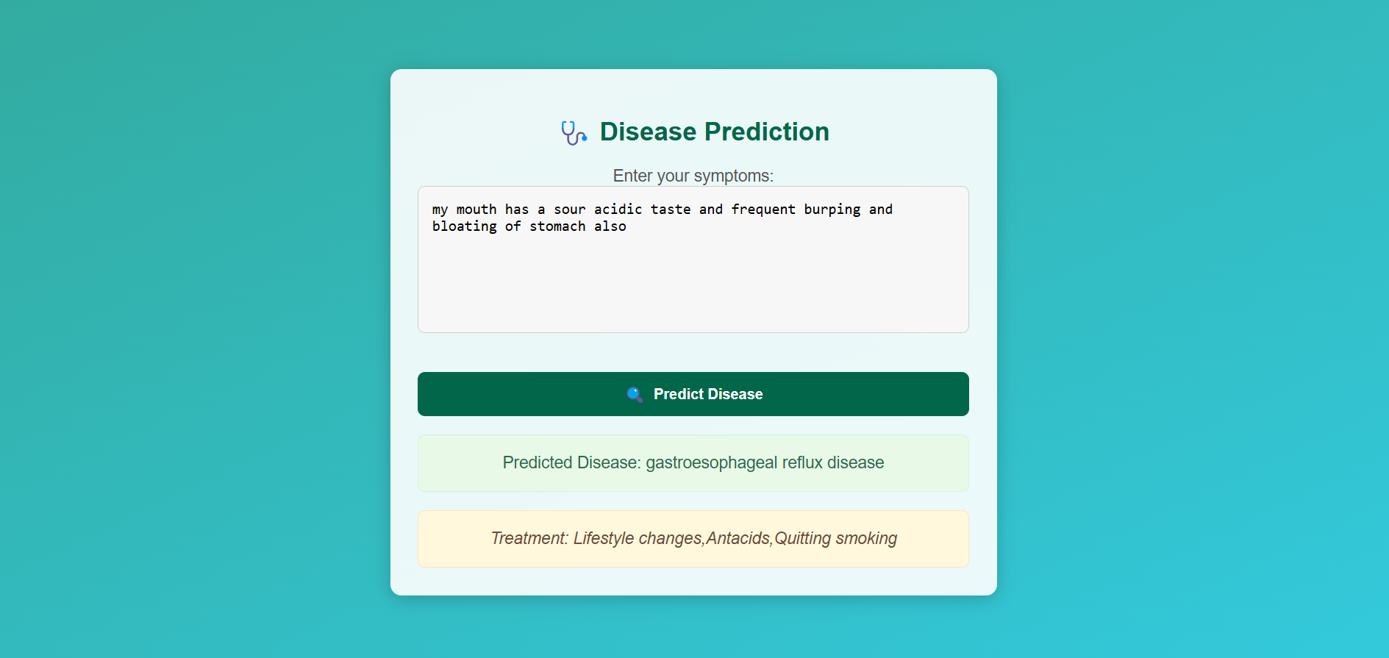

Slide 14
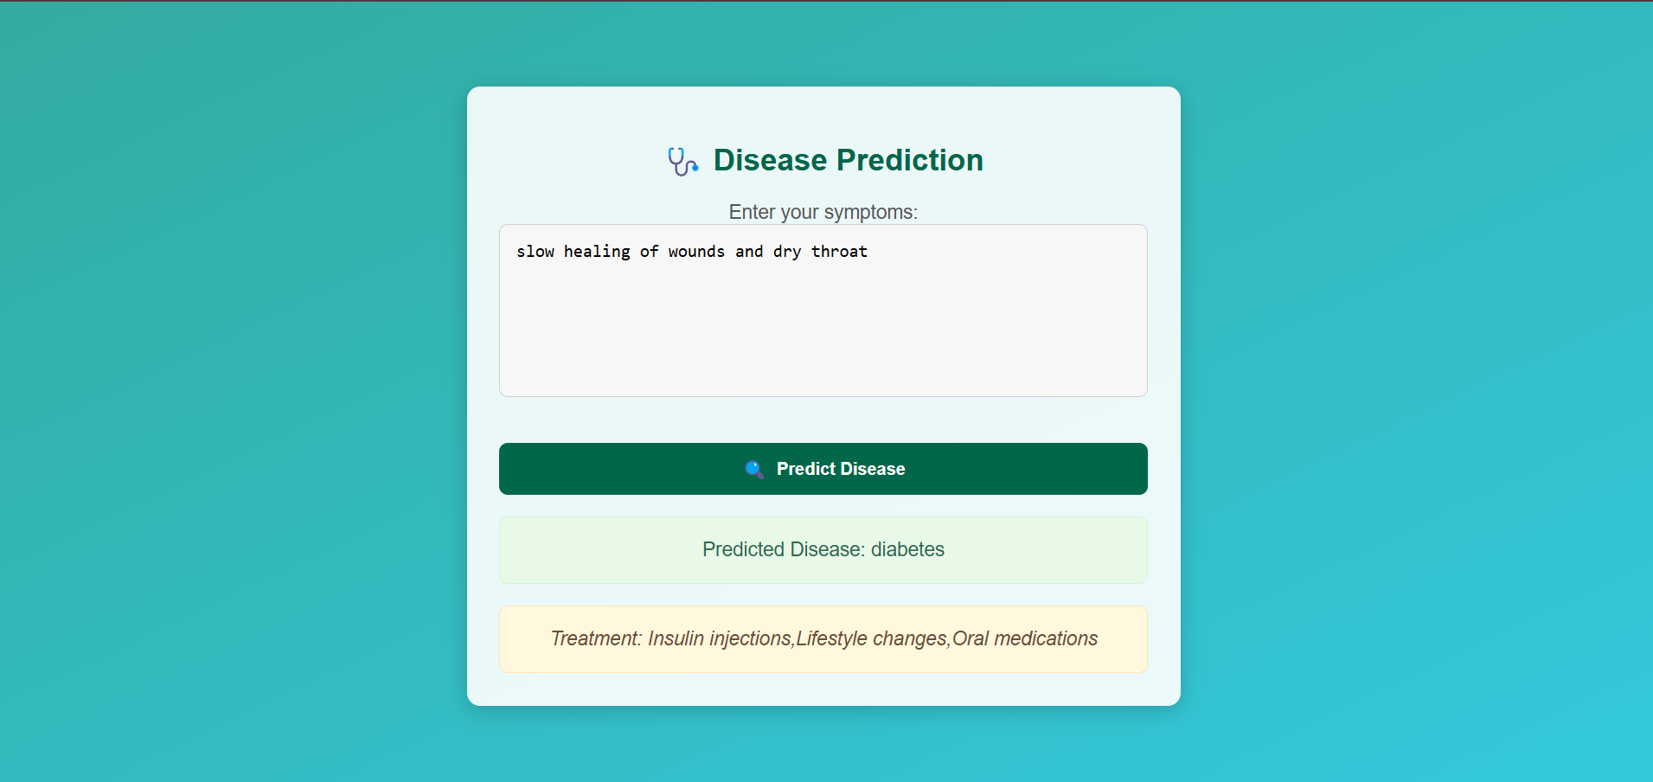

Slide 15
FUTURE ENCHANCEMENT
Cross Platform - Develop a mobile app so that users can access the prediction system more easily
Larger Dataset – Including a dataset with more values more values for more accurate prediction
Increasing Classification Range – Can add more disease classes for predicting more diseases

Slide 16
THANK YOU

